Slide 1

Leveraging Cardiac Data for Predictive Disease Modelling: A Comprehensive Approach
Mulweli Mudau
January 2025

Slide 2
Introduction
Objective: Building a predictive model that classify individuals as either having or not having heart disease by analysing a comprehensive set of patient attributes, including demographic, clinical, and lifestyle factors.
Overview:
Data overview and key points
Data processing
Exploratory data analysis
Building Machine learning models
Evaluation of models built
Results and discussions
Conclusion :machine learning used to classify outcome

Slide 3
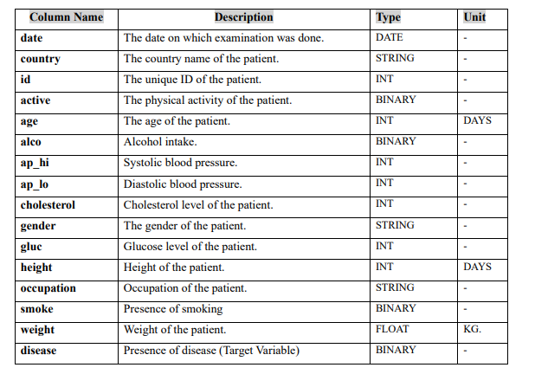
Data Description
Dataset Summary:
Key points: 16 columns, 70000 entries , non-null , and age in days.

Slide 4
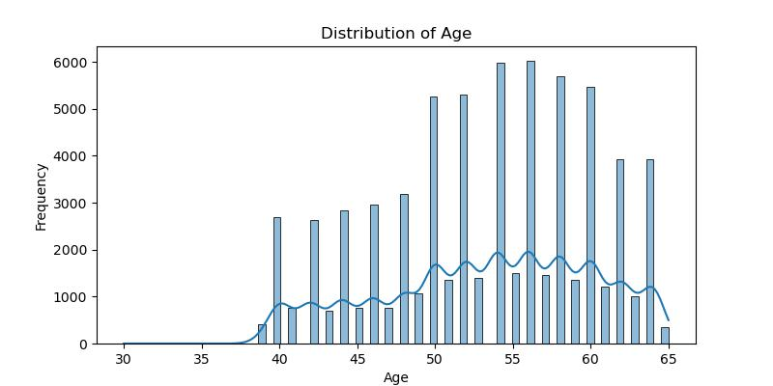
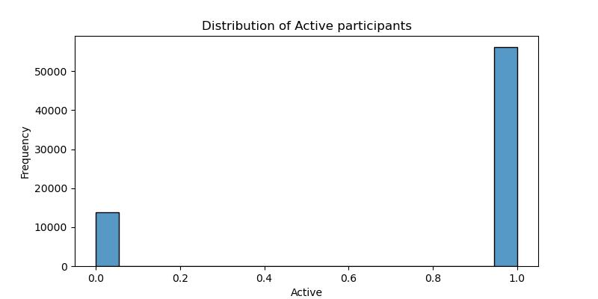
Exploratory Data Analysis
Distribution of Age
Distribution of Active and Non-Active Participants

Slide 5
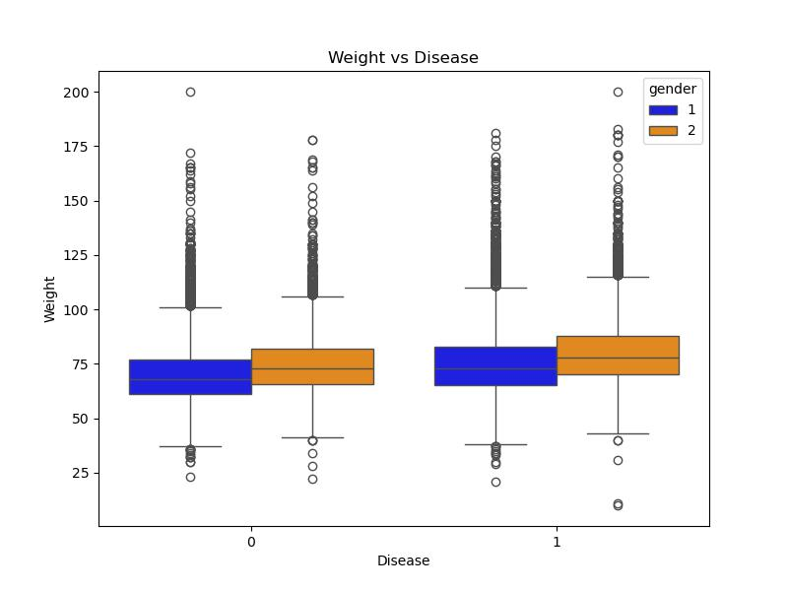
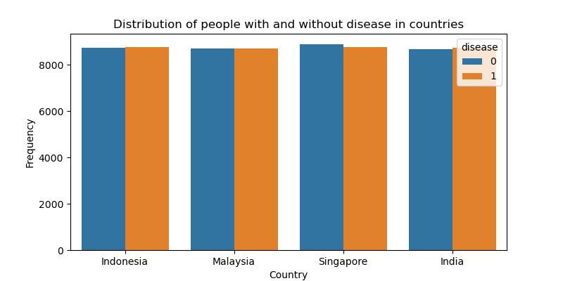
Exploratory Data Analysis Continued
Distribution of disease in country
Distribution of disease depending on weight of patient

Slide 6
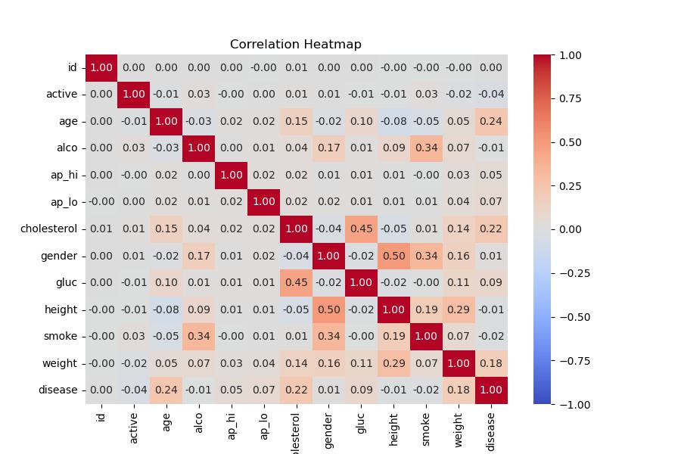
Exploratory Data Analysis Continued
Heatmap showing correlation of numeric data

Slide 7
Data Preprocessing
Outline of the preprocessing steps taken:
Handle missing values.
Change age to years.
Dropping unnecessary columns .
Encoding categorical variables.

Slide 8
Machine Learning Models
Models selected:
Logistic Regression
K-Nearest Neighbours
Support Vector Machine
Decision Tree
Training and testing: 80% of data for training and 20% for training the models.

Slide 9
Evaluation methods
Performance Metrics
Classification report
Accuracy: how many predictions got right.
Precision: Out of predictions how many are correct.
Recall: Correct predictions out of the truth.
F1-score: Overall of recall and precision
Confusion Matrix: Truth vs prediction.(Diagonal correct and off diagonal incorrect)

Slide 10
Results
Models | Accuracy | Precision | Recall | F1-score
Logistic Regression | 71% | 72% | 71% | 71%
K-Nearest Neighbors | 71% | 71% | 71% | 71%
Support Vector Machines | 71% | 71% | 71% | 71%
Decision Tree | 73% | 73% | 73% | 72%

Slide 11
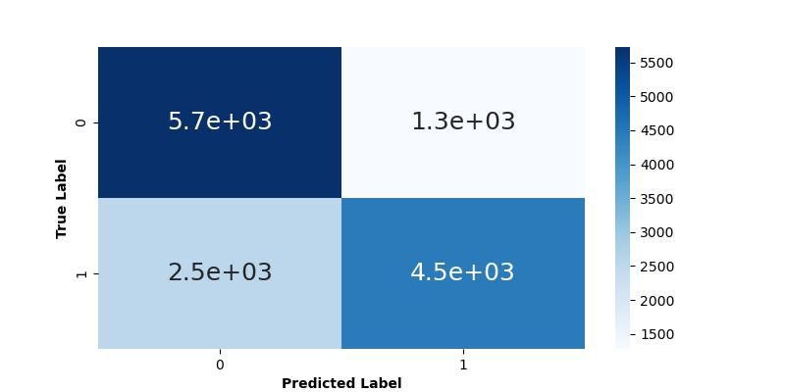
Results
Decision Tree Confusion matrix

Slide 12
Discussion & Conclusion
The results from building the models indicate that the Decision Tree is the best-performing model in terms of accuracy, precision, recall, and F1-score. K-Nearest Neighbors (KNN), Support Vector Machines (SVM), and Logistic Regression achieve similar accuracy, recall, and F1-score (micro average), though Logistic Regression exhibits a different precision compared to KNN and SVM.
In conclusion, we will use the Decision Tree model to classify whether a person has heart disease or not.

Slide 13
Q&A

